Slide 1
APPLICATION LAYER
Unit - 5
part-1
CNS
Bikram Ghosh

Slide 2
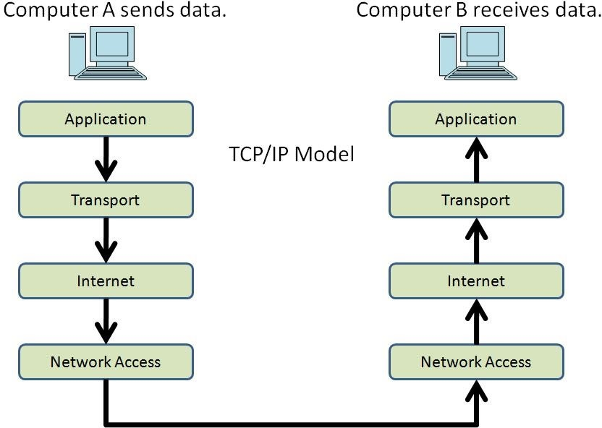
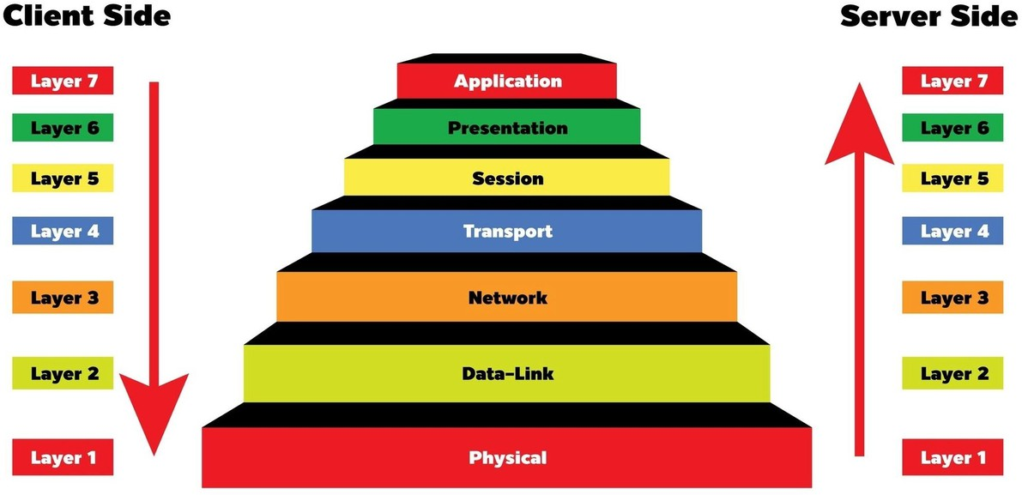
Introduction:
It is the layer where users directly interact with the network through applications. The Application Layer is the topmost layer of the OSI model and the TCP/IP model . It provides services like web browsing, email, and file transfer by using protocols (e.g., HTTP, FTP, SMTP, DNS) that allow software applications to communicate
and share data over the Internet.

Slide 3
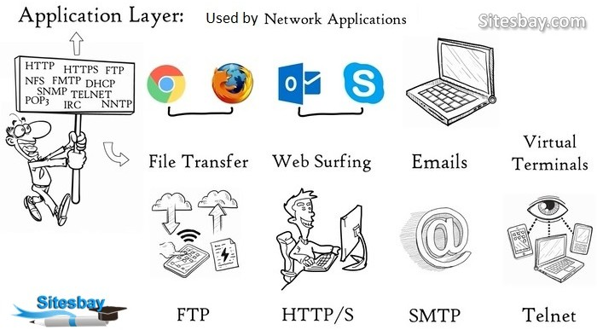
/SFTP
/IMAP
/POP3
DNS → Domain name resolution
DHCP →Dynamic Host Configuration Protocol MIME - Multipurpose Internet Mail Extensions

Slide 4
Overview of Application Layer Protocols:
HTTP / HTTPS (Hypertext Transfer Protocol / Secure) Used for browsing websites.
HTTPS adds encryption for security.
DNS (Domain Name System)
Converts domain names (e.g., www.google.com) into IP addresses.
DHCP (Dynamic Host Configuration Protocol)
Automatically assigns IP addresses and network configurations to devices.
SMTP (Simple Mail Transfer Protocol) Used for sending emails.
IMAP / POP3
Used for retrieving emails from servers.
FTP (File Transfer Protocol) / SFTP
Used to upload and download files between client and server.
MIME (Multipurpose Internet Mail Extensions)
Allows emails to include images, audio, video, and attachments.
Telnet
Provides remote login to another computer (not secure, replaced by SSH).
SNMP (Simple Network Management Protocol) Used to monitor and manage network devices.

Slide 5


WWW (World Wide Web):
-Inventor: Sir Tim Berners-Lee
in 1989 & HTML in 1990.
-The World Wide Web (WWW) is a large global information system on the Internet where information is stored in the form of hypertext documents.
-Each document (webpage) can contain links (hyperlinks) that connect to other documents, allowing users to navigate easily.
-These documents are written using HTML (HyperText Markup Language).
- https://info.cern.ch/hypertext/WWW/TheProject.html

Slide 6
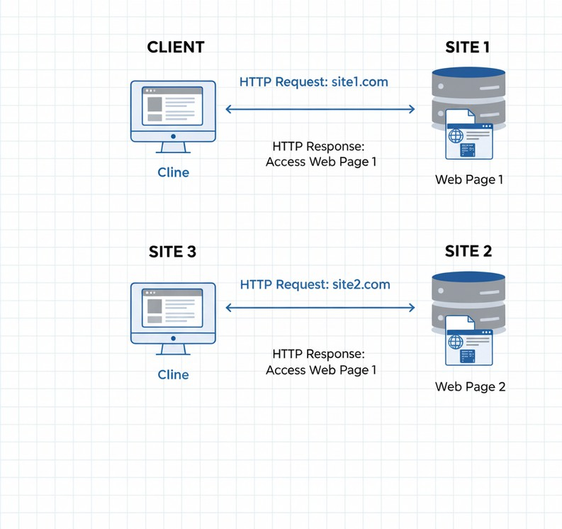
How WWW Works :
User Request (Browser Input):
You type a URL like https://www.example.com into a browser.
DNS Resolution:
Browser asks the (DNS) to convert the domain name (www.example.com) into an IP address (e.g., 142.250.182.14).
Connection Setup:
WWW Architecture
Browser establishes a TCP connection (or TLS for HTTPS) with the web server’s IP address . Then Browser sends an HTTP request (usually GET) asking for the webpage.
4. Server Response & Rendering :
The web server processes the request and sends back an HTTP response containing the HTML document, CSS, JavaScript, images, etc.
Browser reads the HTML → downloads linked resources (CSS, JS, media) → displays the fully rendered page to the user. [NEXT same process again & again].

Slide 7
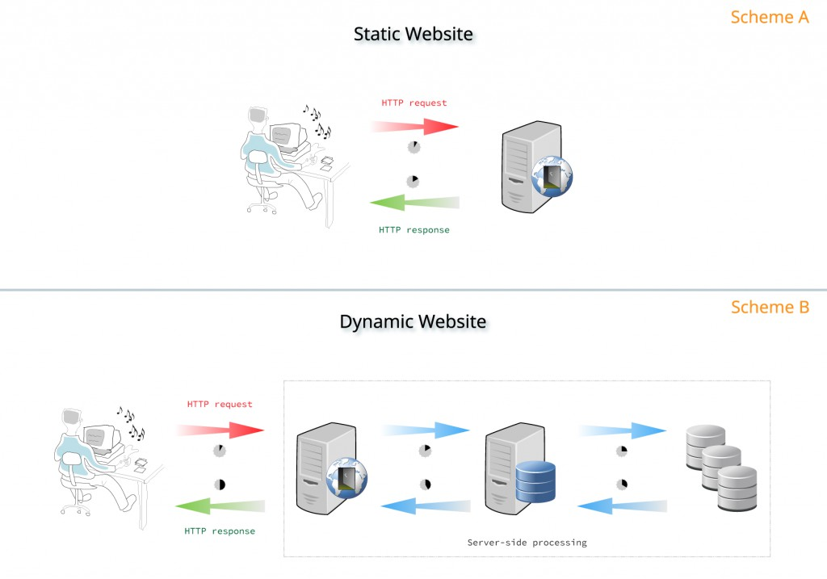
Static Document:
A document whose content is fixed and does not change unless manually updated by the web developer.
This content are created and stored in a server. If requiredd cline can get a copy.
Ex: A simple portfolio website.
Dynamic Document:
A document whose content is generated at runtime based on user interaction, inputs, or database queries.
Technology used: Server-side scripting (PHP, Node.js, Python, Java, ASP.NET) + Databases (MySQL, MongoDB).
Ex: Online shopping cart on Amazon.

Slide 8
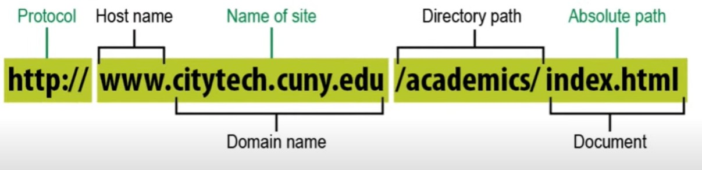
HTTP (HyperText Transfer Protocol):
The protocol for communication between web clients and servers. Works on TCP (port 80 for HTTP, 443 for HTTPS).
Request Methods:
GET – Retrieve data
POST – Send data to server PUT – Update data
DELETE – Remove data
PATCH – Partially update data
Response Codes:
200 OK → Success
301 Moved Permanently → Redirection 404 Not Found → Resource missing
500 Internal Server Error → Server problem

Slide 9
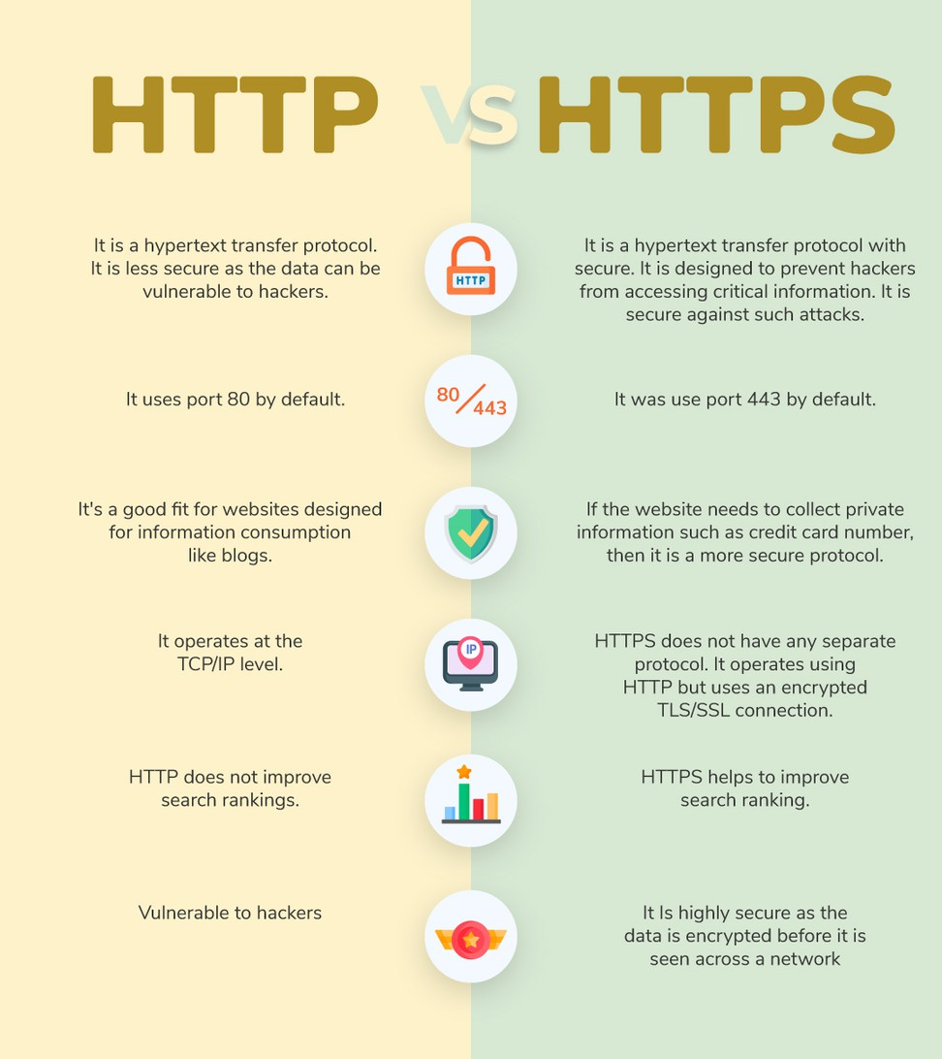
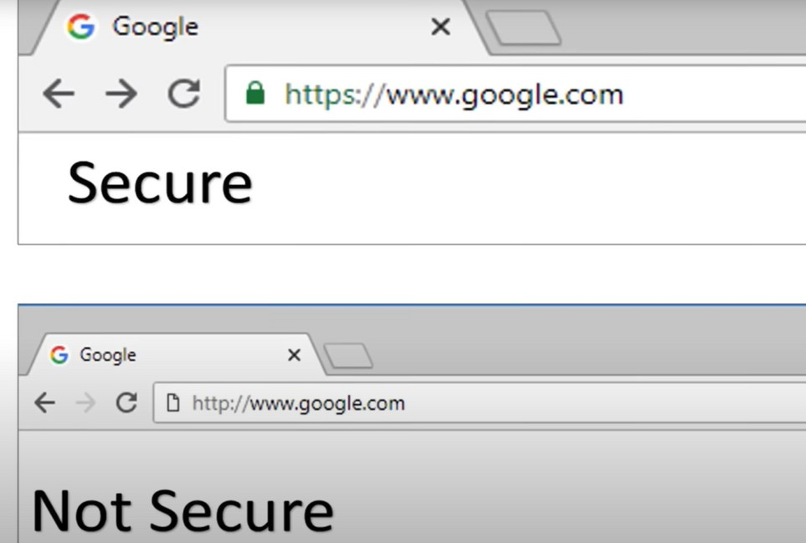
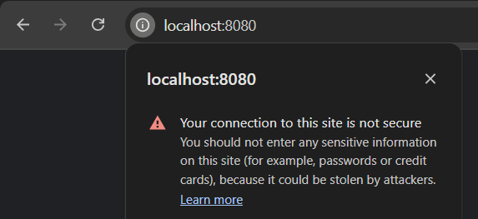

Slide 10
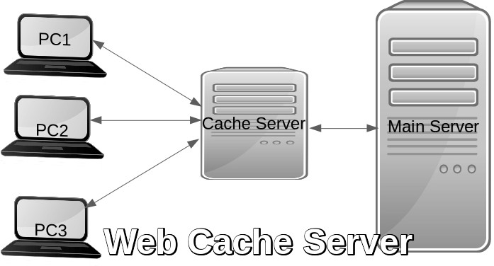
Web Caching:
Definition: Temporarily storing web resources (HTML pages, images, scripts) closer to the user to reduce latency and bandwidth usage.
Types of Caching
Browser Cache – Stored locally on user’s device.
Proxy Cache – Stored in an intermediate server (e.g., ISP).
Content Delivery Network (CDN) – Distributed cache servers globally.
Benefits:
Reduces server load. Decreases response time. Saves bandwidth.
Cache Control in HTTP Headers:
Cache-Control: max-age=3600 Resource is valid for 1 hour.

Slide 11
Example of Web Caching
Scenario:
You open www.youtube.com for the first time.
The browser downloads logo.png, CSS, JavaScript files, and stores them in the browser cache.
Next time you visit YouTube, instead of downloading the logo again from the server, the browser fetches it from the local cache, so the page loads faster.
Another Example (Proxy / ISP Cache):
Suppose 1,000 students in a university open the same Wikipedia page. Without caching → All 1,000 requests go to the Wikipedia server.
With caching (proxy server at university) → The first request fetches the page, and the next 999 requests are served from the cache.
This saves bandwidth and makes access faster.

Slide 12
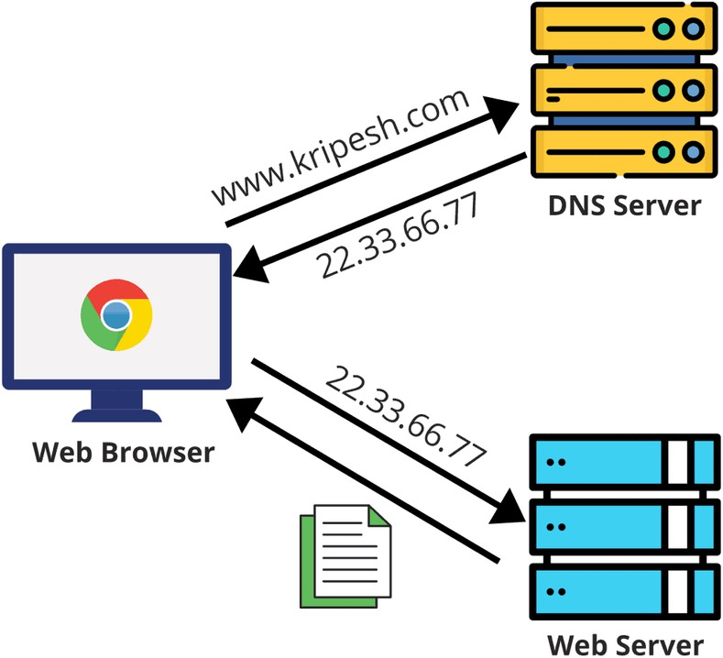
DNS (Domain Name System):
Definition: Translates human-readable domain names (e.g., www.google.com) into IP addresses (e.g., 142.250.182.14).
Easier to remember names than IP addresses.
Provides flexibility: if IP changes, the domain remains the same.
Types of DNS Records:
A → Maps domain to IPv4 address. AAAA → Maps domain to IPv6 address. CNAME → Alias for another domain.
MX → Mail exchange server.
NS → Authoritative name servers.
HTTP request
HTTP response

Slide 13
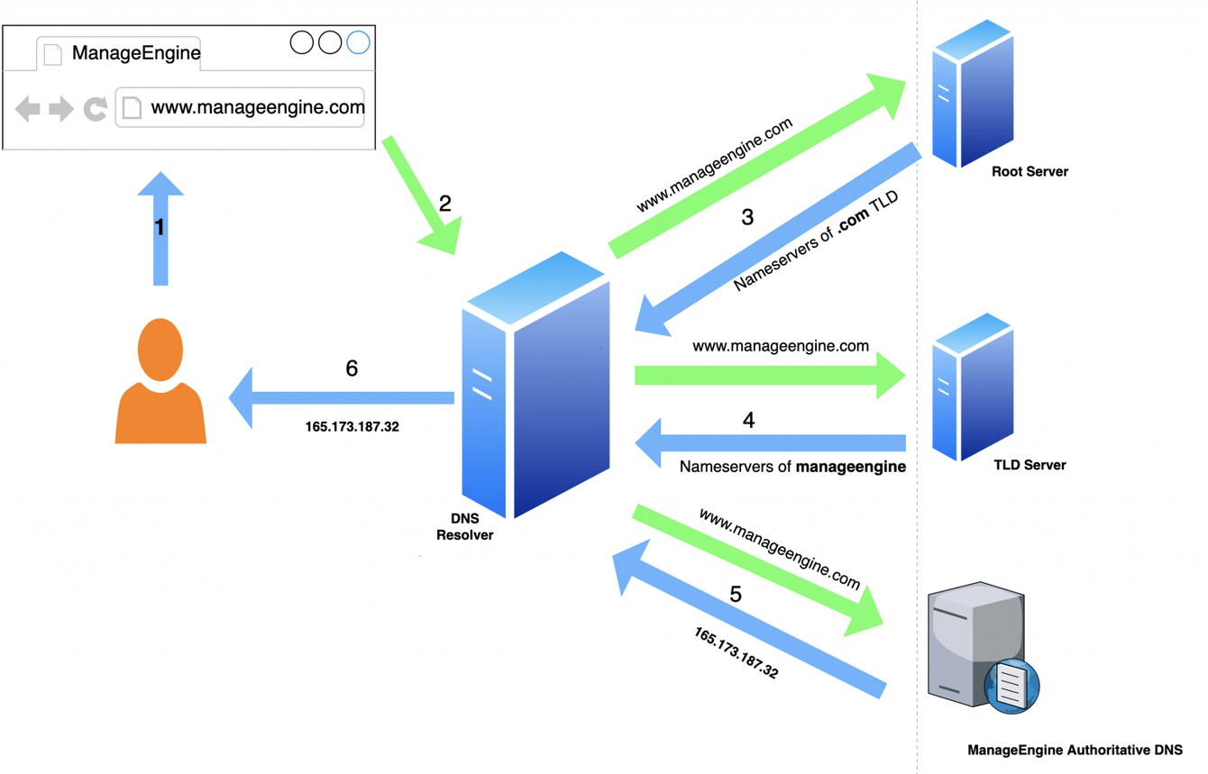
How does DNS Work ?
User enters www.example.com in browser.
Browser checks local cache.
If not found, query goes to Recursive Resolver (usually ISP). Resolver queries Root Server → directs to TLD server (.com).
TLD server points to Authoritative DNS Server (for example.com).
Authoritative server provides the IP address. Browser connects to that IP via HTTP/HTTPS.

Slide 14
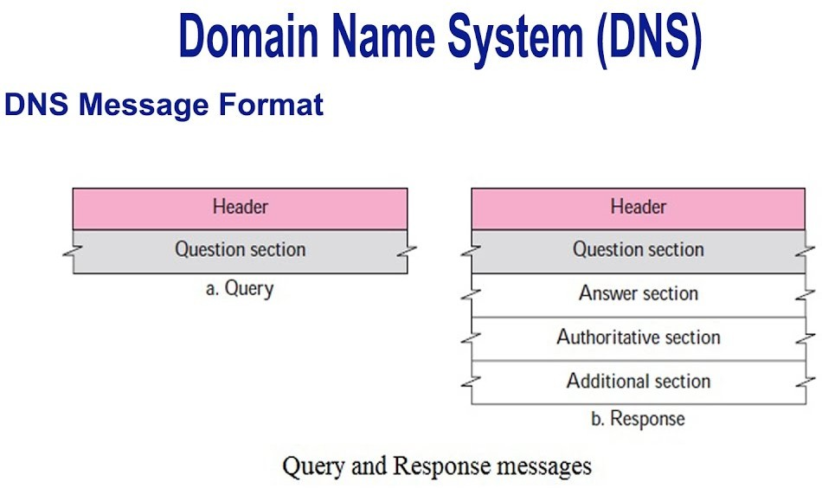
DNS Message Format
Definition: A DNS message is used for communication between a client (resolver) and a DNS server. It has a header and sections.
Types : Query 2. Response
Header Section: Contains metadata about the query or response: ID, QR, Opcode Question Section: Sent by the client to the server.
->The type of query (A, AAAA, MX, etc.).
Answer Section: Contains the resource records (RRs) answering the query.
Example: domain → IP mapping.
Authority Section: Provides information
about authoritative DNS servers for the domain.
Additional Section: Optional info that may help the client, e.g., IP addresses of name servers.

Slide 15
APPLICATION LAYER
Unit - 5
part-2
CNS
Vaibhav Bodade

Slide 16
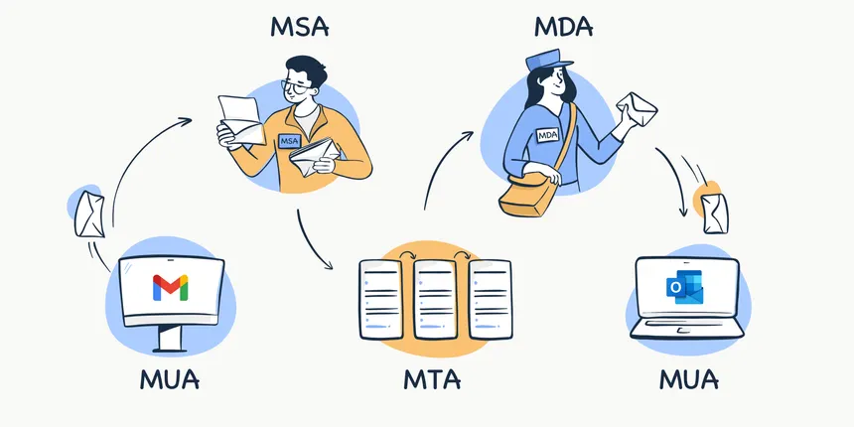
Email Protocols :
Email protocols are a collection of protocols that are used to send and receive emails properly.
The email protocols provide the ability for the client to transmit the mail to or from the intended mail server.
Email protocols are a set of commands for sharing mails between two computers.
There are three basic types of email protocols.
SMTP - Simple Mail Transfer Protocol
POP3 - Post Office Protocol v3
MIME - Multipurpose Internet Mail Extention
Webmail - Web based email service

Slide 17
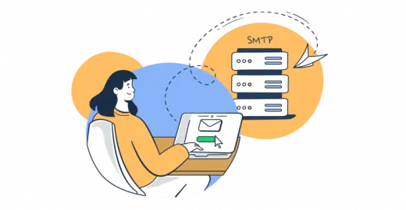
Simple Mail Transfer Protocol (SMTP)
SMTP (Simple Mail Transfer Protocol) is an application layer protocol used for sending and forwarding emails between mail clients and mail servers over the Internet.
It is the standard protocol used to send emails across the Internet.
Works at the Application Layer of the OSI and TCP/IP models.
Uses TCP port 25 (or port 587 for secure submission, port 465 for SMTPS).
What Kind of Data SMTP Transfers :
- Text messages (basic email body).

Slide 18
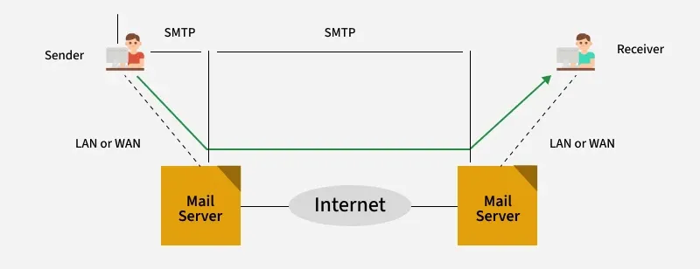
Simple Mail Transfer Protocol (SMTP)
User sends email → Email client (like Outlook, Gmail app) sends the email to the SMTP server.
SMTP server processes it → Checks recipient’s domain (@gmail.com, @yahoo.com).
If same domain → Delivers directly to recipient’s mailbox.
If different domain → SMTP server forwards it to recipient’s SMTP server using the Internet.
Recipient’s server stores the email until the user retrieves it (via POP3 or IMAP).

Slide 19
Simple Mail Transfer Protocol (SMTP)
Advantages of SMTP
Reliable way to send emails.
Simple, standardized protocol used worldwide.
Supports relay servers, so email can hop across multiple servers.
Can handle bulk emails.
Disadvantages of SMTP
Not secure by default (messages are plain text).
Can be exploited for spam or phishing.
Only handles sending, not receiving (needs POP3/IMAP for inbox)
Applications of SMTP
Sending emails from client to server.
Relaying emails between mail servers (e.g., Gmail → Yahoo).
Used in webmail, email clients, and mailing services.
Automated systems (notifications, password resets, alerts).

Slide 20
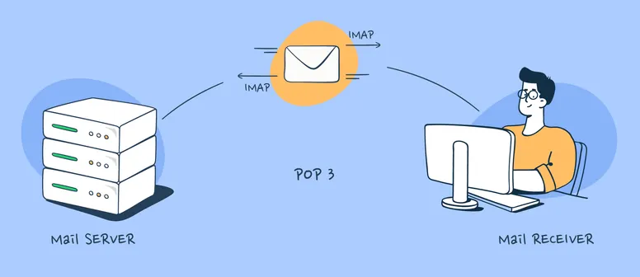
Post Office Protocol v3 (POP3)
POP (Post Office Protocol) is an Internet standard protocol (introduced in 1984) that works at the application layer to access emails from a mail server.
It is mainly needed when users do not have a continuous internet connection and want to download and read emails offline.
POP3 (Post Office Protocol v3) is the updated version of POP that allows retrieving and deleting messages from the server, storing them locally for offline access.
What Kind of Data SMTP Transfers :
- Text messages (basic email body).

Slide 21
Post Office Protocol v3 (POP3)
Working of POP3 -
Connection – Email client (like Outlook, Thunderbird, Gmail app) connects to the mail server using POP3.
Authentication – User logs in with username & password.
Transaction –
Server sends a list of emails.
Client downloads selected/all emails.
By default, emails are deleted from the server once downloaded (can be configured to keep a copy).
Update – Server updates mailbox status and closes the session.

Slide 22
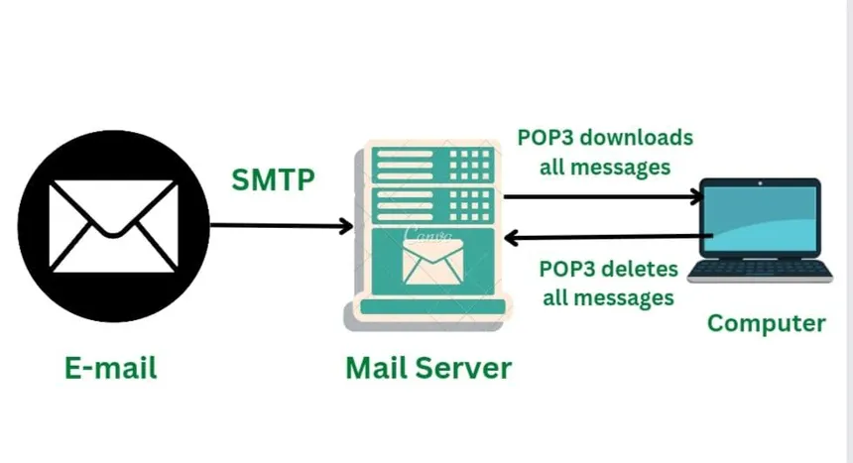
Post Office Protocol v3 (POP3)

Slide 23
Post Office Protocol v3 (POP3)
Advantages of POP3
Emails are available offline after download.
Reduces server storage usage (since emails are removed after download).
Disadvantages of POP3
Emails not accessible from multiple devices (downloaded to one device).
If device crashes, emails may be lost (since server copy is deleted).
Applications of POP3
Personal email retrieval (used in older clients like Outlook Express, Eudora).
Simple email download for single-device users.
Lightweight systems where server storage is limited.

Slide 24
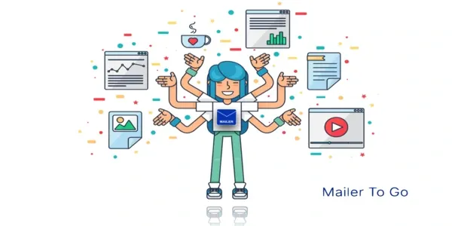
Multipurpose Internet Mail Extention (MIME)
MIME (Multipurpose Internet Mail Extensions) is a standard used to extend the format of email messagesallowing them to include more than just text.
It enables the transmission of multimedia content such as images, audio, video, and attachments, within email messages, as well as other types of content types.
MIME works by encoding the message content in a way that ensures it can be transmitted over email protocols like SMTP without loss of data or corruption.
What Kind of Data SMTP Transfers :
- Text messages (basic email body).
- Audio, Video, images etc.,

Slide 25
Multipurpose Internet Mail Extention (MIME)
Advantages:
Supports attachments (images, videos, documents).
Allows HTML emails with rich formatting.
Supports non-English characters using Unicode.
Disadvantages:
Increases email size (Base64 encoding inflates data).
Email processing is slightly more complex than plain text emails.
Applications:
Sending attachments via email.
Sending HTML newsletters or formatted emails.
Supporting multilingual content in emails.

Slide 26
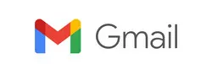
WEBMAIL - Web-based email service
Webmail, also known as web-based email, is an email service that allows users to access, send, receive, and manage their email accounts through a web browser without the need to install dedicated email client software on a device.
This service operates as a cloud-based system, meaning email messages are stored on remote servers managed by the email provider, such as Gmail, Yahoo Mail, Outlook.com, or ProtonMail.
Users can access their accounts from any device with an internet connection and a compatible web browser, providing significant flexibility and convenience, especially for those who need to stay connected from multiple locations or devices

Slide 27

WEBMAIL - Web-based email service
Working of Webmail -
User logs in to their webmail account via a browser.
Browser sends a request to the web server.
Web server communicates with the email server to retrieve messages.
Email server uses SMTP to send outgoing emails.
Email server uses IMAP or POP3 to receive and store incoming emails.
Web server displays the emails in the browser interface for the user.
Actions like reading, deleting, or organizing emails are synchronized across all devices.

Slide 28
THANK YOU

